Slide 1
E-Learning System
Presented by:
Susovan Maji(64)-22022002016018
Sourajit Ghosh(59)-22022002016014

Slide 2
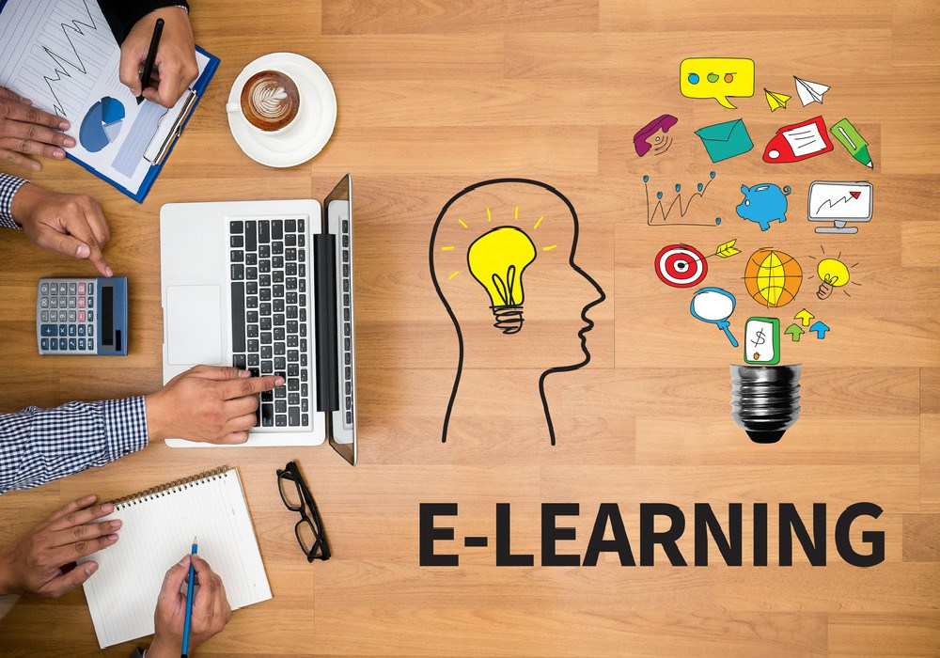
What is E-learning System?
E-learning, short for electronic learning, is a system of education that utilizes electronic technologies, primarily the internet, to deliver educational content and resources to learners. An e-learning system encompasses a wide range of online tools and platforms that facilitate various aspects of learning, including course delivery, interaction, assessment, and management.
HVVI

Slide 3
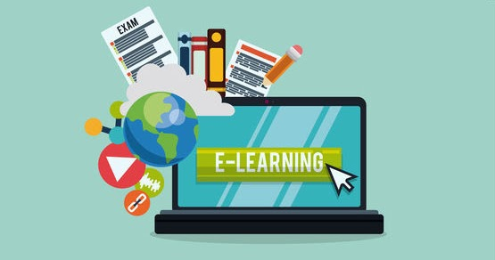
TYPES OF E-LEARNING
Online Courses: These are structured educational programs offered entirely online, allowing students to access course materials, lectures, and assignments remotely.
Virtual Classrooms: These platforms simulate traditional classrooms in an online environment, enabling real-time interactions between instructors and students through video conferencing, discussion boards, and live chat.
Learning Management Systems (LMS): LMS platforms provide a centralized hub for organizing, managing, and delivering educational content, tracking student progress, and administering assessments.
Massive Open Online Courses (MOOCs): MOOCs are online courses aimed at unlimited participation and open access via the web. They typically offer video lectures, interactive forums, and automated grading systems.
Interactive Learning Tools: These tools include simulations, educational games, and multimedia resources that engage learners in interactive and immersive learning experiences.
This Photo by Unknown Author is licensed under CC BY

Slide 4
USING E-LEARNING
E-learning platforms are versatile and can be used for a wide range of educational and training
purposes. Here are various things that can be accomplished using e-learning platforms:
Formal Education:
Deliver complete K-12 or higher education courses.
Provide online college or university degrees and programs.
Support test preparation and tutoring services.
Professional Development:
Offer online courses and certifications to help professionals acquire new skills or upgrade existing ones.
Provide training for industry-specific certifications.
Deliver compliance training for employees in various industries.
Corporate Training:
Conduct employee onboarding and orientation.
Offer ongoing employee training and development.
Train employees on company policies, procedures, and software tools.
Skills Training:
Provide training for a wide range of skills, from programming and data analysis to design and
communication skills.
Offer language learning courses.
Teach vocational skills, such as carpentry, plumbing, and culinary arts.
Soft Skills Development:
Offer courses on leadership, teamwork, time management, and other soft skills.
Provide training on effective communication and conflict resolution.

Slide 5
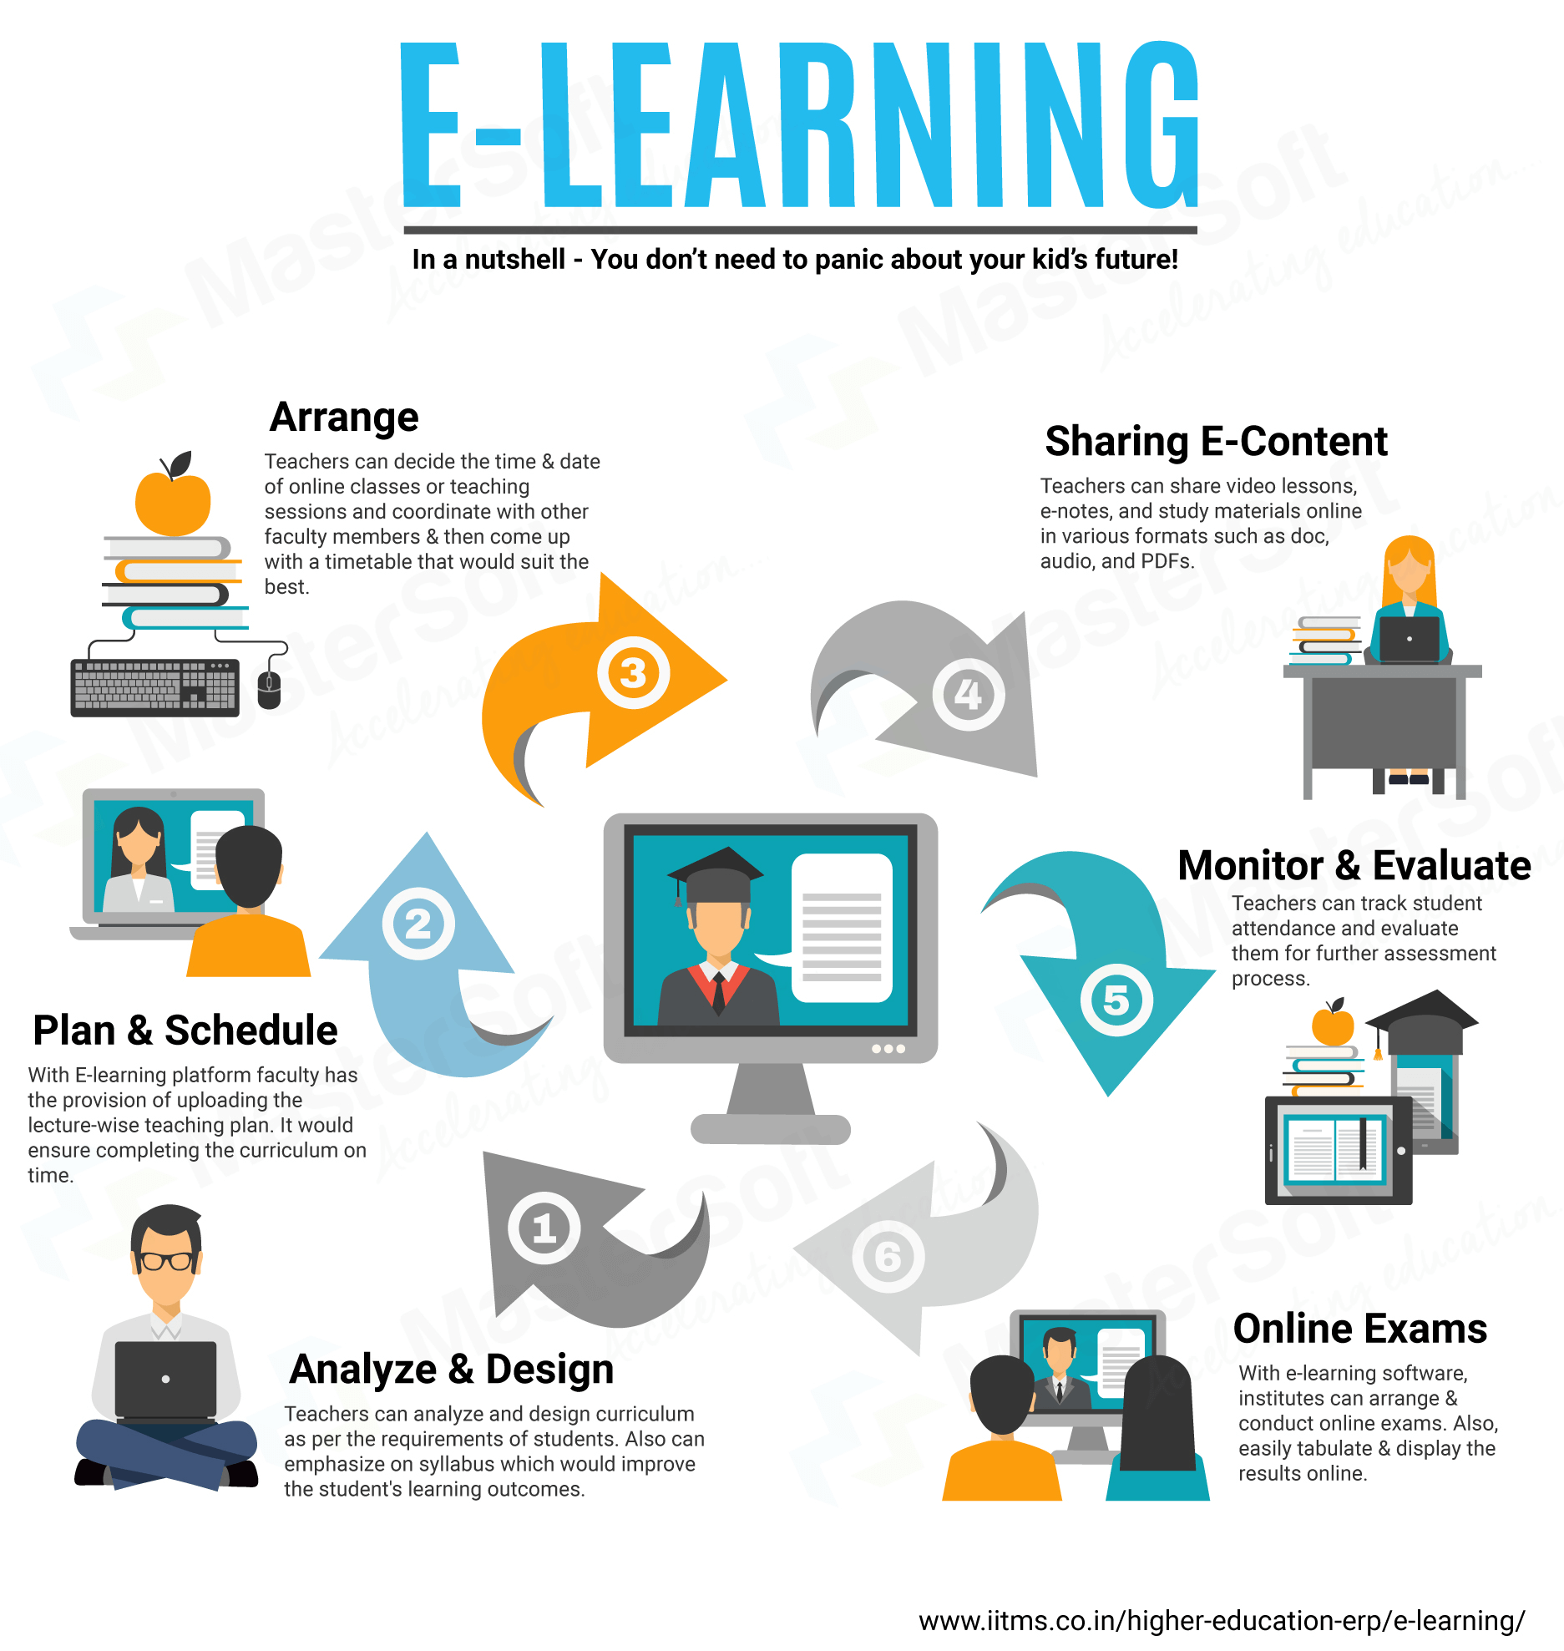
BENEFITS OF E-LEARNING
There are many benefits of E-Learning. Some of them are presented below:
Accessibility: E-learning enables learners to access educational materials from anywhere with an internet connection, breaking down geographical barriers. This accessibility is particularly valuable for individuals in remote or underserved areas.
Flexibility: E-learning allows learners to set their own schedules and choose when and where they study. It accommodates diverse learning styles and helps individuals balance their education with other commitments, such as work or family.
Self-Paced Learning: E-learners can progress through course materials at their own pace. This self-paced learning approach allows students to spend more time on challenging topics and move quickly through familiar ones.
Cost-Effective: E-learning often reduces costs associated with traditional education, including commuting, physical textbooks, and classroom infrastructure. It also eliminates the need for printed materials.
Personalization: E-learning platforms can use data and analytics to personalize learning experiences, providing content and assessments tailored to individual learners' strengths and weaknesses. Etc.

Slide 6

CONCLUSION
In conclusion, this presentation has shed light on the critical aspects of plagiarism detection and prevention. We've discussed the various types of plagiarism, the consequences of unethical practices, the definition and purpose of plagiarism checkers, and popular tools to aid in this process. Plagiarism remains a significant concern in both educational and professional settings, and it is paramount that we remain vigilant in our efforts to address this issue. The need for plagiarism detection and prevention cannot be overstated. Upholding academic and professional integrity is not only a moral obligation but also essential for personal and collective growth. The ethical use of information and originality in one's work are the cornerstones of a successful academic and professional journey, and plagiarism checkers are valuable allies in this pursuit. We encourage everyone to continue applying the knowledge and insights gained from this presentation to maintain the highest standards of integrity and originality in their writing endeavors.
This Photo by Unknown Author is licensed under CC BY

